Slide 1
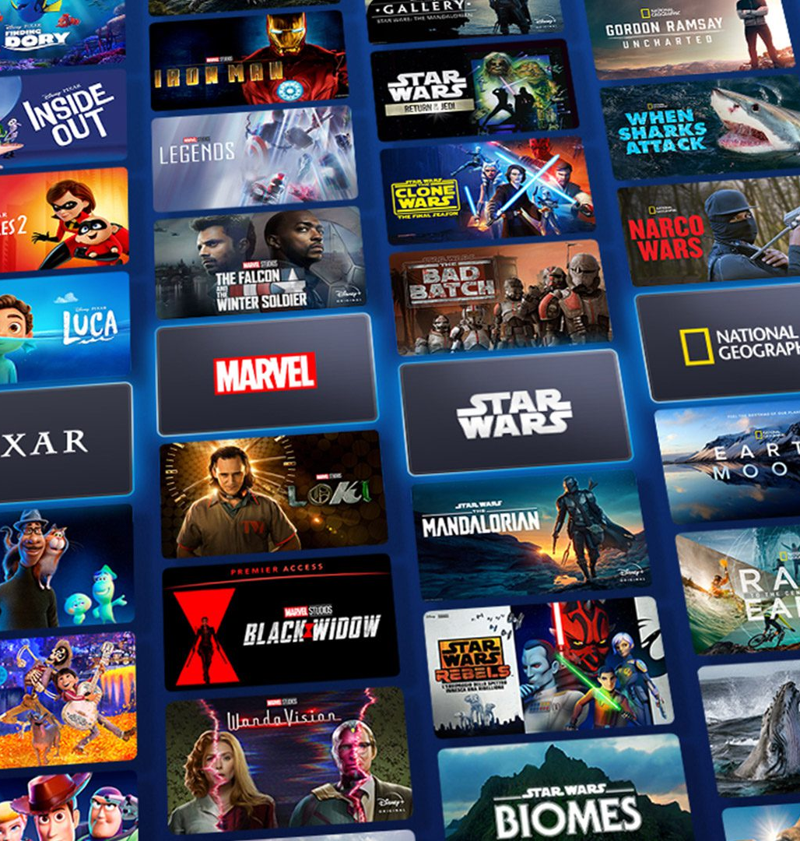
Recommendation System for Disney+ Shows and Movies
Presented by: Group 11
Name | ID | Role
Nasir Uddin Ahmed | S2015449 | Leader
Muhammad Shahzad Rafiq | S2150889 | Maker
Qixiang Yin | S2150692 | Oracle
Low Boon Kiat | 17138399 | Presenter

Slide 2
Introduction & Motivation
Problem Statement
Project Objective
Scope & Domain
DS Pathway
Dataset
Collaborator / End User
EDA
Conclusion
Table of Content
01
Introduction & Motivation
06
Dataset
02
Problem Statement
07
Collaborator / End User
03
Project Objective
08
EDA
04
Scope & Domain
09
Conclusion
05
DS Pathway

Slide 3

Introduction & Motivation
Problem Statement
Project Objective
Scope & Domain
DS Pathway
Dataset
Collaborator / End User
EDA
Conclusion
Introduction
Launch of Disney+
4
In Nov 2019, Disney released its own streaming platform Disney+
Popular streaming platforms
Netflix, Amazon Prime Video, Hulu, HBO Max, YouTube Premium, Apple TV+
1
5
Popular, classic content on Disney+
Large library of content from Disney, Pixar, Marvel, Star Wars, National Geographic, etc.
Attract youngsters
Wide variety of TV shows and movies
2
6
Growing fast
Currently, over 160 million users worldwide subscribe to Disney+
3
New culture of binge-watching
Provide flexibility for users to watch their favorite TV shows and movies at any time on any device

Slide 4
Introduction & Motivation
Problem Statement
Project Objective
Scope & Domain
DS Pathway
Dataset
Collaborator / End User
EDA
Conclusion
Motivation
Share of streaming media users in the U.S. who paid for the respective streaming services in the past 12 months
79%
69%
55%
52%
Recommendation System
33%
26%
20%
Propose relevant content to users based on prior watching history and interests.
Offer personalized suggestions that users are more likely to find interesting and relevant.
Increase user retention and generate more revenue.
Netflix
Amazon Prime
Hulu
Disney+
HBO Max
YouTube Premium
Apple TV+
Source: Statista Global Consumer Survey 2021
A gap of 27% difference between Netflix and Disney+ in terms of user base.
Considering that Disney+ was only launched in November 2019, it has huge potential to overtake Netflix as the world’s biggest streaming platform.

Slide 5
Introduction & Motivation
Problem Statement
Project Objective
Scope & Domain
DS Pathway
Dataset
Collaborator / End User
EDA
Conclusion
Problem Statement
Paradox of Choice
We tend to get overwhelmed quickly and make poor choices when presented with many options.
This theory also applies to streaming media where users are presented with thousands of video content.
Schwartz (2016)
Gomez-Uribe & Hunt (2015)
“Having too many choices often led us to take more effort for making a decision and can eventually leave us feeling unsatisfied with our own choice.”
“A typical streaming media user loses interest after spending 60 to 90 seconds reviewing 10 to 20 titles on one or two screens with chances of only 3 titles being reviewed in detail.”
Recommendation system can help users to choose and make decision-making process easier.

Slide 6
Introduction & Motivation
Problem Statement
Project Objective
Scope & Domain
DS Pathway
Dataset
Collaborator / End User
EDA
Conclusion
Project Objective
1
To build a recommendation system for Disney+ shows and movies that is accurate, efficient and scalable.
2
To evaluate the performance of the recommendation system using a variety of metrics.
3
To deploy the recommendation system to production.

Slide 7

Introduction & Motivation
Problem Statement
Project Objective
Scope & Domain
DS Pathway
Dataset
Collaborator / End User
EDA
Conclusion
Scope & Domain
Streaming Media Industry
According to Fortune Business Insights 2022, streaming media industry is projected to be worth US$330 billion by 2030.
Witnessed tremendous growth in subscribers through integration of recommendation systems.
Domain
Building Recommendation System for
Recommendation system helps users to choose video content they like, and overcome paradox of choice.
Disney+ aggressively forecasted that it will surpass Netflix subscribers number in 2024.
Scope

Slide 8
Introduction & Motivation
Problem Statement
Project Objective
Scope & Domain
DS Pathway
Dataset
Collaborator / End User
EDA
Conclusion
DS Pathway
5 Key Points of the DS Pathway for the Project
Problem Definition
Data Collection
01
02
Involves data acquisition, cleaning, formatting, and preprocessing to ensure its quality and compatibility for analysis.
Understanding the project's objective, conducting background research, and gaining domain knowledge.
Results & Communication
Model Development
EDA
05
04
03
Analyzing the characteristics of the data, identifying outliers, and understanding relationships between variables.
Creating visualizations, reports, or presentations to present insights to stakeholders, enabling them to make informed decisions based on the data analysis.
Training the models, tuning parameters, and evaluating their performance.

Slide 9
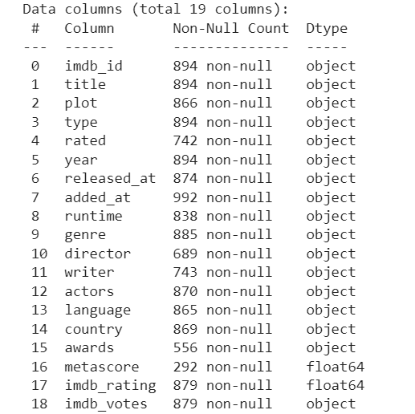
Introduction & Motivation
Problem Statement
Project Objective
Scope & Domain
DS Pathway
Dataset
Collaborator / End User
EDA
Conclusion
Dataset
1
17 Categorical Features & 2 Numerical Features
2
18 Variables have missing value problem
3
74 Duplicate entries were found
19 Variables
992 Observations
408 KB in Size
4
After Data Cleaning 918 Observations
Source: Kaggle.com

Slide 10


Introduction & Motivation
Problem Statement
Project Objective
Scope & Domain
DS Pathway
Dataset
Collaborator / End User
EDA
Conclusion
Collaborator, End User
Data scientists, streaming platform experts, and Disney+ stakeholders collaborate to develop a recommendation system. Their expertise in data analysis, machine learning, industry insights, and platform alignment ensures personalized content suggestions aligned with user preferences and platform goals.
The recommendation system personalizes suggestions based on user preferences, considers factors like genre, director, and actors. Measures are taken for efficiency and scalability, user privacy, and data protection. It provides explanations, evaluates and improves performance, adapts to evolving trends, ensures accuracy, and enhances the user experience.

Slide 11
Introduction & Motivation
Problem Statement
Project Objective
Scope & Domain
DS Pathway
Dataset
Collaborator / End User
EDA
Conclusion
EDA
Load Data
The initial step in the exploratory data analysis (EDA) process involves loading the data into the analysis environment, ensuring accessibility for further analysis.
Pre-Processing
Load Data
Findings
Data pre-processing includes handling missing values, handling outliers, data cleaning, and transforming the data into a suitable format for analysis, ensuring data quality and integrity.
Pre-Processing
Visualization
Visualization
Visualizing the data through charts, graphs, and plots helps in gaining insights and identifying patterns, trends, and relationships within the data, enabling better understanding and decision-making.
Findings
EDA uncovers valuable insights. It reveals the distribution of variables, identifies correlations, uncovers outliers, and highlights significant patterns, providing a comprehensive understanding of the dataset's characteristics and potential insights.

Slide 12
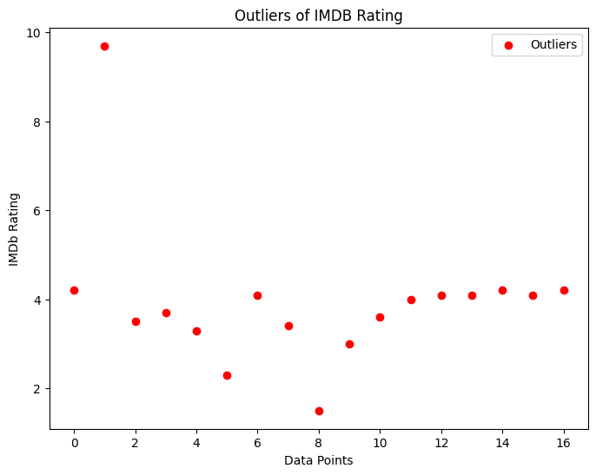
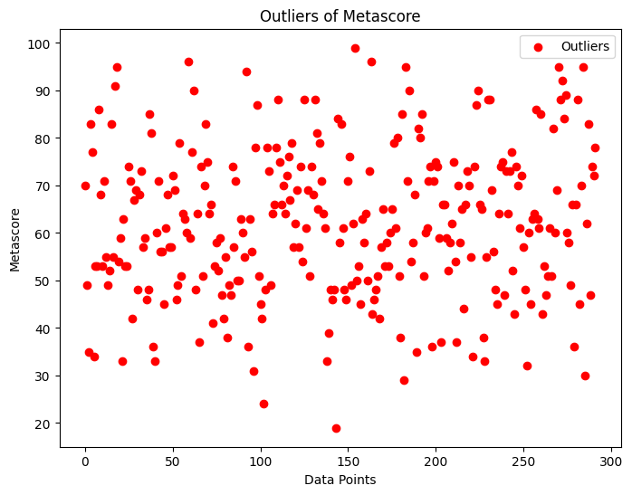
Introduction & Motivation
Problem Statement
Project Objective
Scope & Domain
DS Pathway
Dataset
Collaborator / End User
EDA
Conclusion
EDA (Detecting Outliers)
IMDB ratings are user-generated scores that reflect the overall sentiment towards a movie or TV show.
Outliers in IMDB ratings may indicate a significant deviation from the general audience perception.
Metascore is a weighted average of critic reviews, providing a consolidated assessment of a movie or TV show.
Outliers in Metascores may suggest a disparity between critical reception and audience opinion.

Slide 13
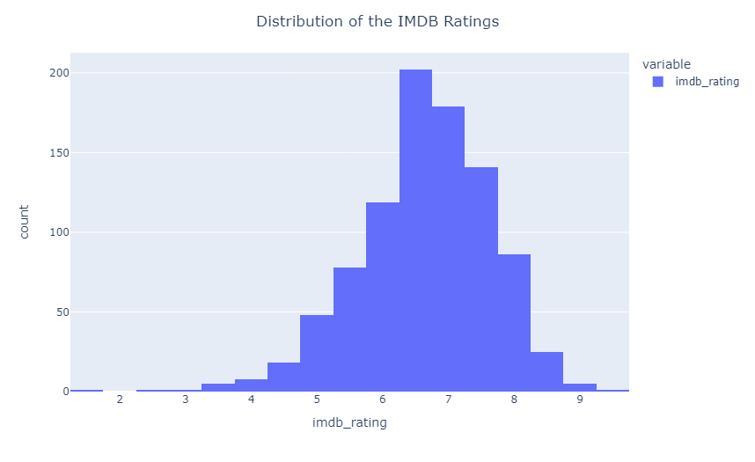
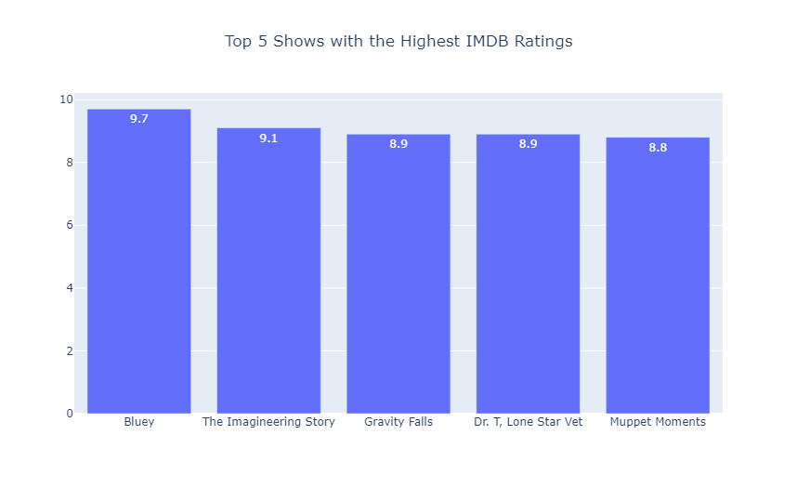
Introduction & Motivation
Problem Statement
Project Objective
Scope & Domain
DS Pathway
Dataset
Collaborator / End User
EDA
Conclusion
EDA (Visualization)
IMDB ratings provide valuable insights into the audience perception and reception of movies and TV shows.
Understanding the distribution of IMDB ratings is essential for assessing the overall quality and popularity of content on Disney Plus.

Slide 14
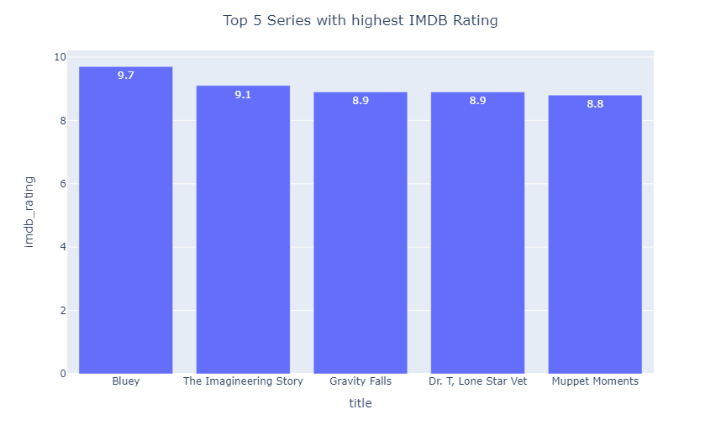
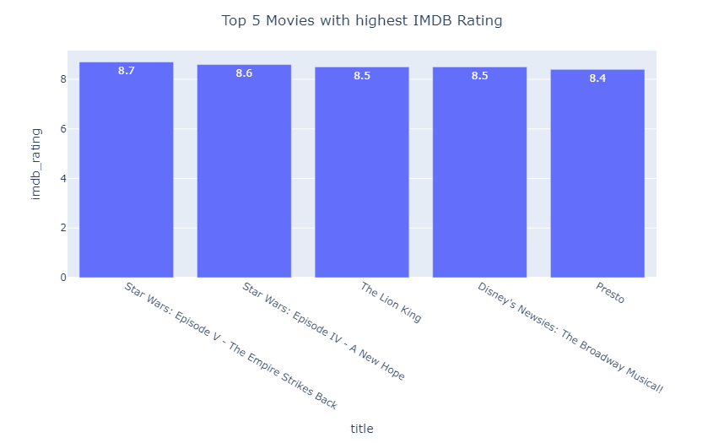
Introduction & Motivation
Problem Statement
Project Objective
Scope & Domain
DS Pathway
Dataset
Collaborator / End User
EDA
Conclusion
EDA (Visualization)

Slide 15
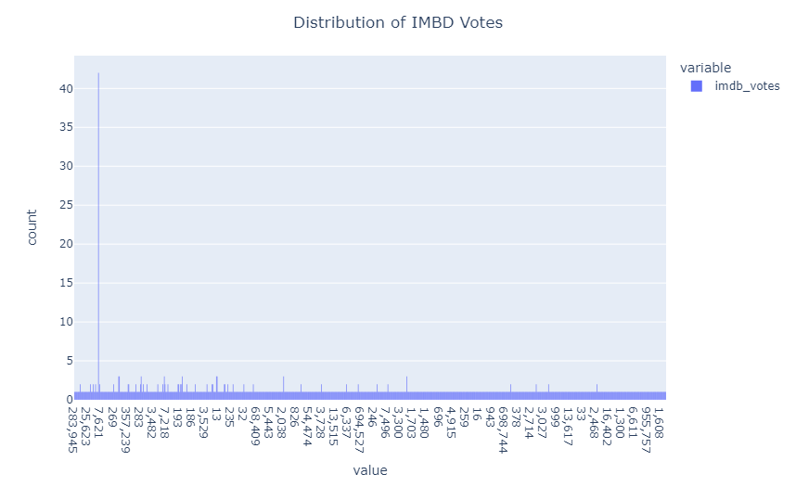
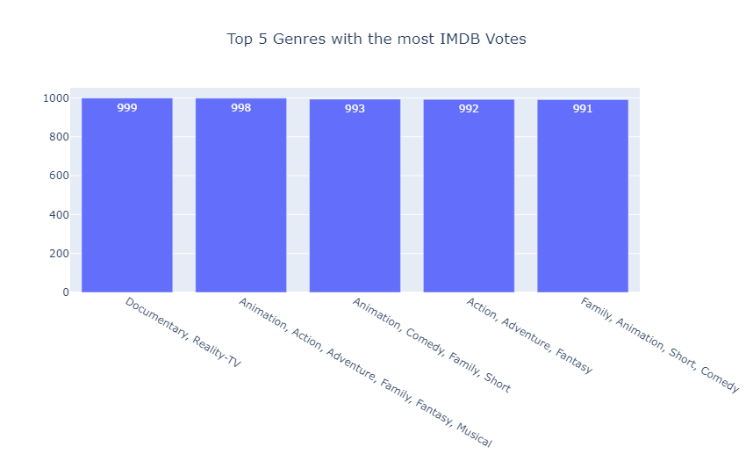
Introduction & Motivation
Problem Statement
Project Objective
Scope & Domain
DS Pathway
Dataset
Collaborator / End User
EDA
Conclusion
EDA (Visualization)
The distribution of IMDB votes represents the spread of votes across different titles available on Disney Plus.
It provides a visual representation of how the votes are distributed, indicating the level of audience involvement.

Slide 16
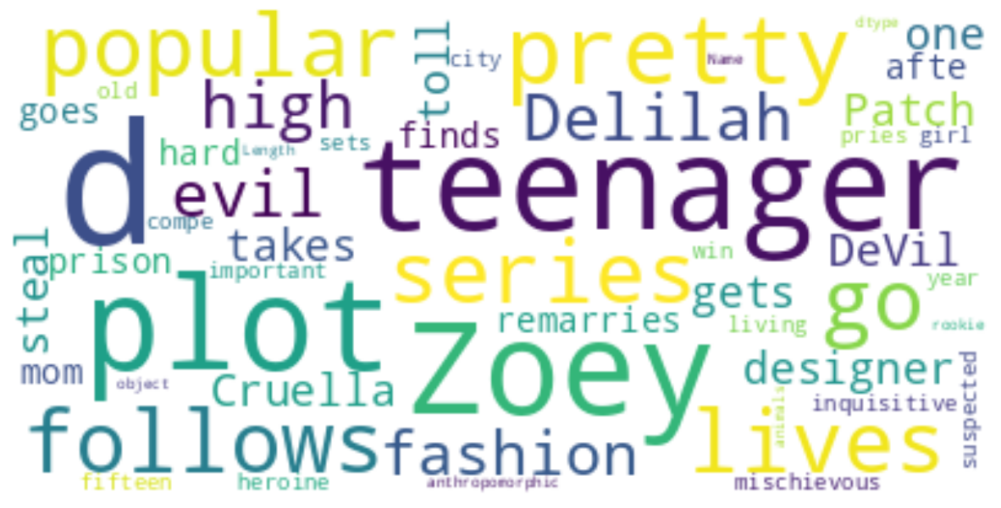
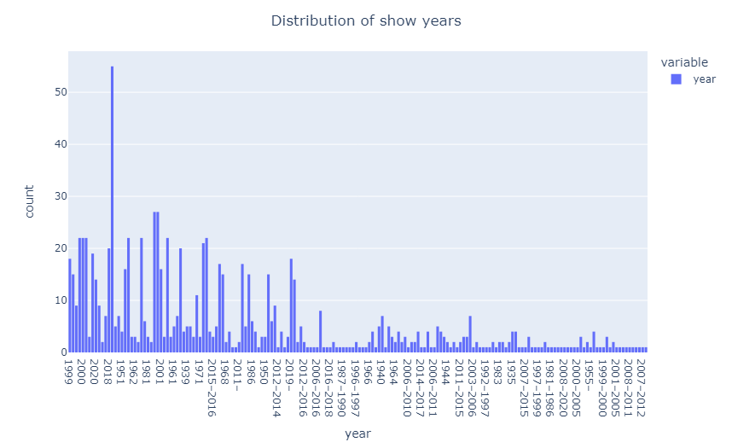
Introduction & Motivation
Problem Statement
Project Objective
Scope & Domain
DS Pathway
Dataset
Collaborator / End User
EDA
Conclusion
EDA (Visualization)
A word cloud visually depicts the frequency of words in a given text, in this case, the titles of Disney Plus content.
Larger words in the cloud represent titles that appear more frequently or have greater prominence on Disney Plus.
The distribution of shows per year showcases the number of shows released in different time periods on Disney Plus.
It helps visualize the content landscape and identify trends and patterns over time.

Slide 17
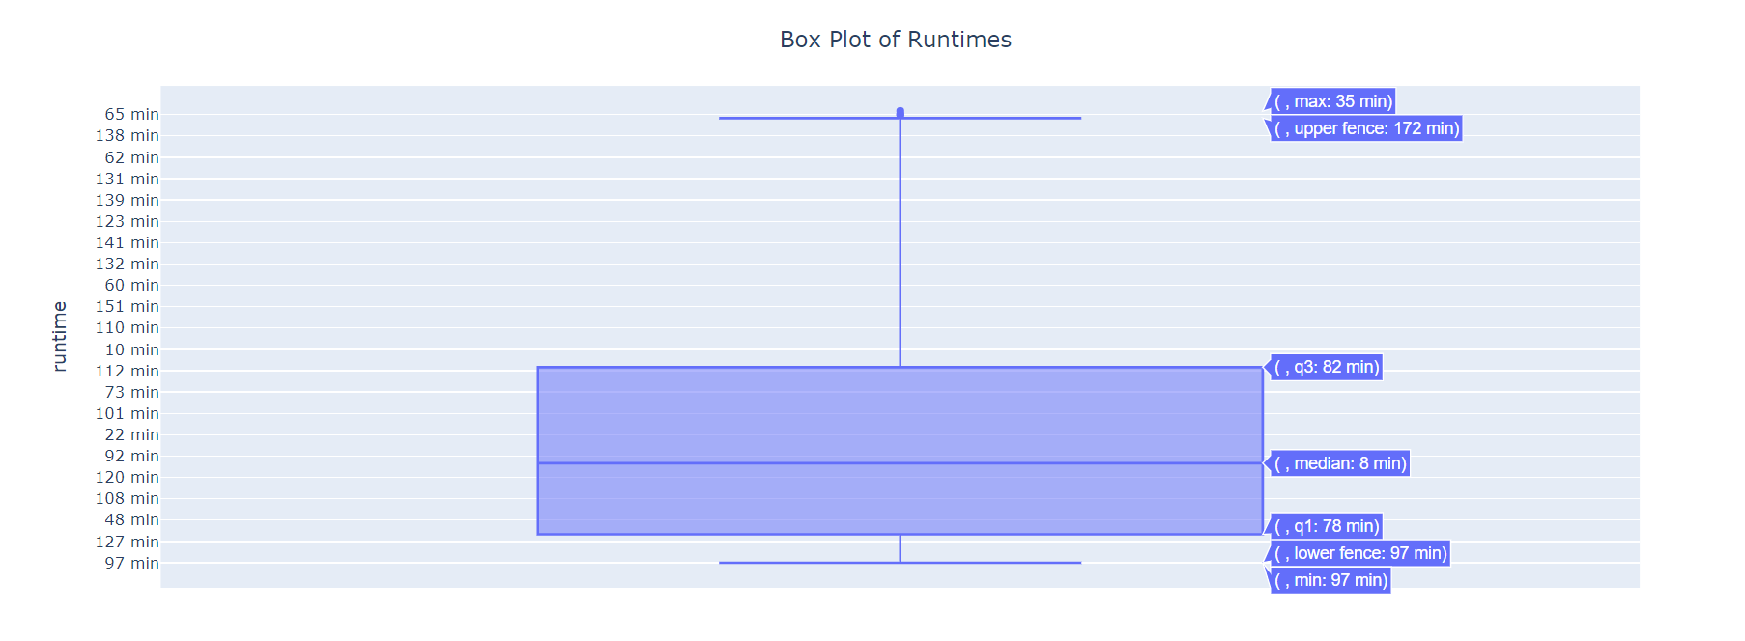
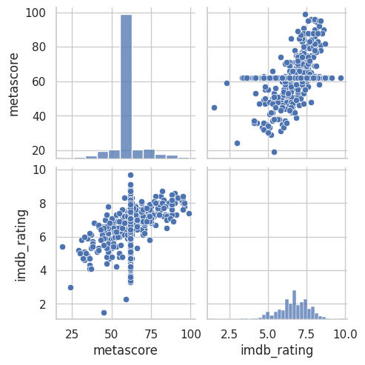
Introduction & Motivation
Problem Statement
Project Objective
Scope & Domain
DS Pathway
Dataset
Collaborator / End User
EDA
Conclusion
EDA (Visualization)
Present a box plot showcasing the distribution of runtimes on Disney Plus.
Average runtime is 35 minutes
Present a pair plot showcasing the relationship between IMDB ratings and Metascores for a selection of movies and TV shows on Disney Plus.
If there is a positive correlation, it indicates that higher IMDb ratings tend to be associated with higher Metascores.

Slide 18
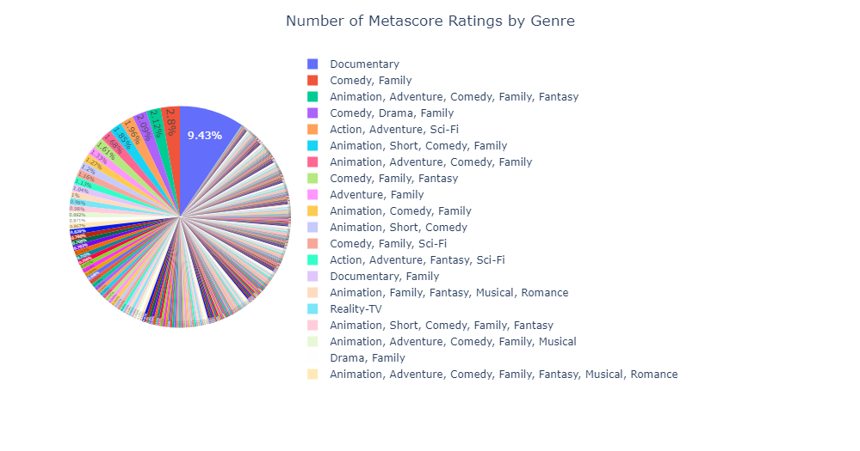
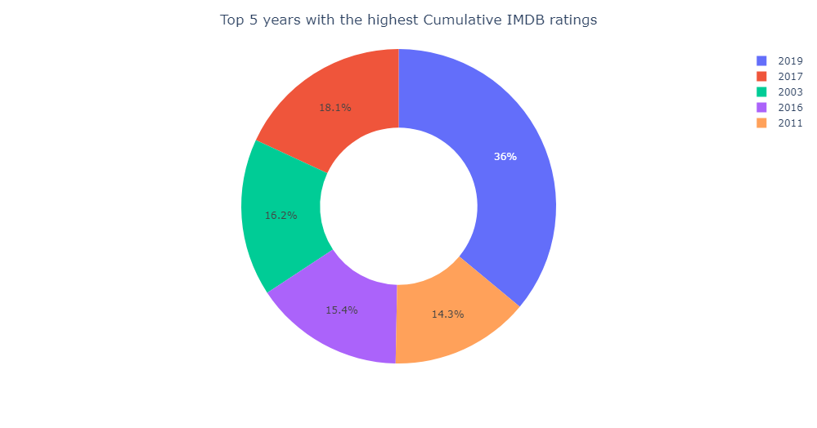
Introduction & Motivation
Problem Statement
Project Objective
Scope & Domain
DS Pathway
Dataset
Collaborator / End User
EDA
Conclusion
EDA (Visualization)

Slide 19
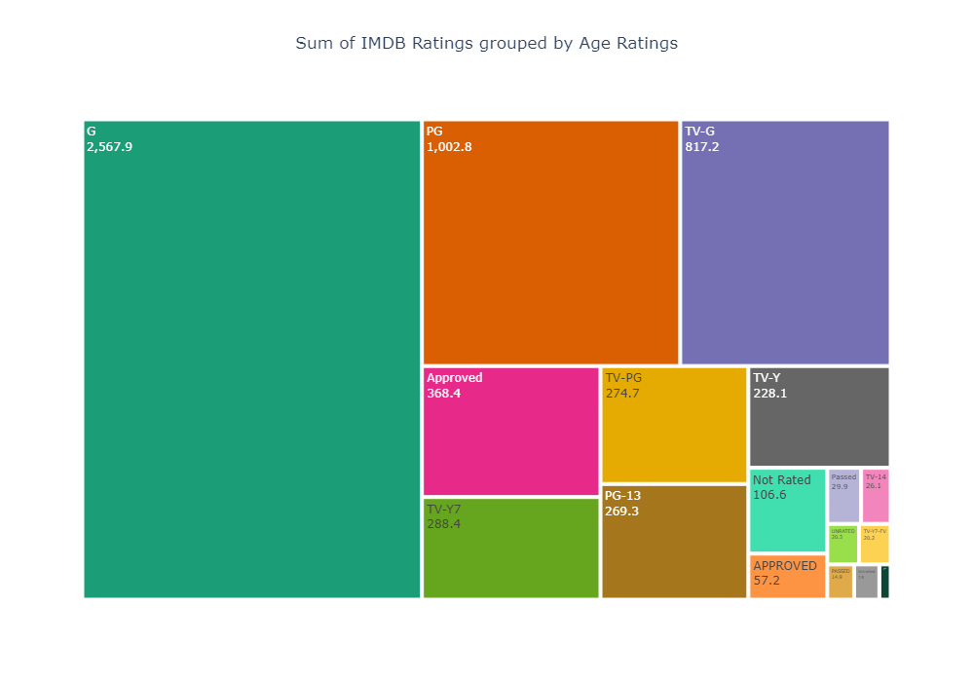
Introduction & Motivation
Problem Statement
Project Objective
Scope & Domain
DS Pathway
Dataset
Collaborator / End User
EDA
Conclusion
EDA (Visualization)
A treemap is a hierarchical visualization that represents data using nested rectangles, with each rectangle representing a category or sub-category.
Provide an overview of the common content rating categories in the United States, such as G, PG, PG-13, R, etc.

Slide 20
Introduction & Motivation
Problem Statement
Project Objective
Scope & Domain
DS Pathway
Dataset
Collaborator / End User
EDA
Conclusion
Conclusion
1
Build a personalized recommendation system for Disney+ shows and movies to enhance the user experience and capitalize on the platform's growth potential.
2
Conduct EDA to understand the dataset, uncover patterns, and guide data preparation and modeling processes.
3
Use descriptive statistics to summarize and gain insights into the dataset's main characteristics, aiding decision-making.
4
Deploy an accurate, efficient, and scalable recommendation system, evaluate performance using metrics, and continuously improve to contribute to Disney+'s success in the streaming media industry.
5
Utilize data science techniques and insights gained from EDA to inform strategic decisions related to content categorization, user preferences, and platform enhancements, ensuring data-driven growth and customer satisfaction.

